Slide 1
A Programmer: loves tests
Python Programming

Slide 2
Unit Tests
Test each non-trivial function
Correct with typical in-range value
Correct with edge-case in-range values
Correct with edge-case out-of-range values
Correct with more extreme out-of-range values
TestClass for each function
member test_fns(): for each condition to be checked
Multiple asserts to check condition is satisfied

Slide 3
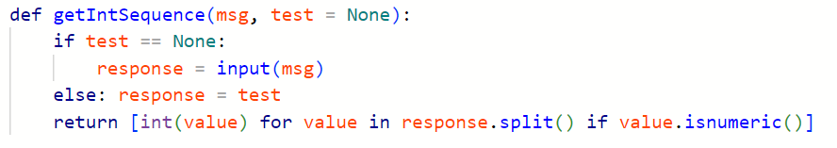
Make UI Testable

Slide 4
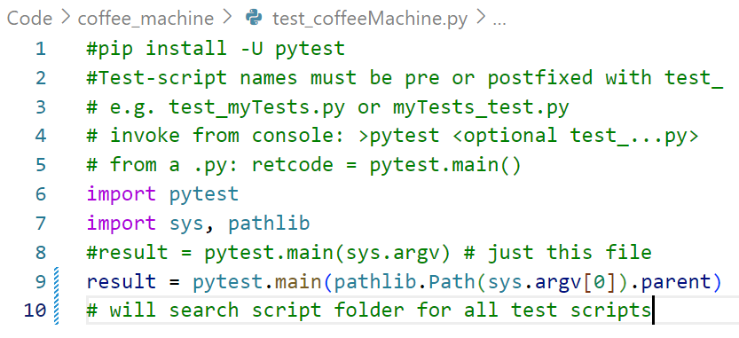
Test "main" in root folder
pytest will find all test_nnn.py modules and run them

Slide 5
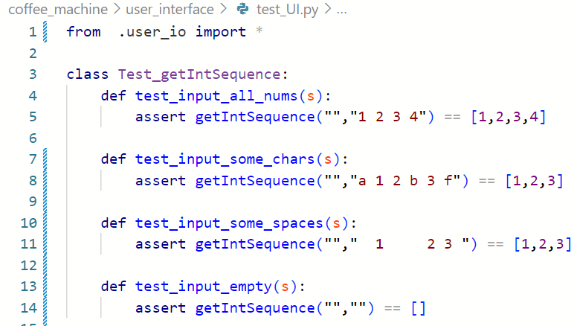
Test-Class

Slide 6
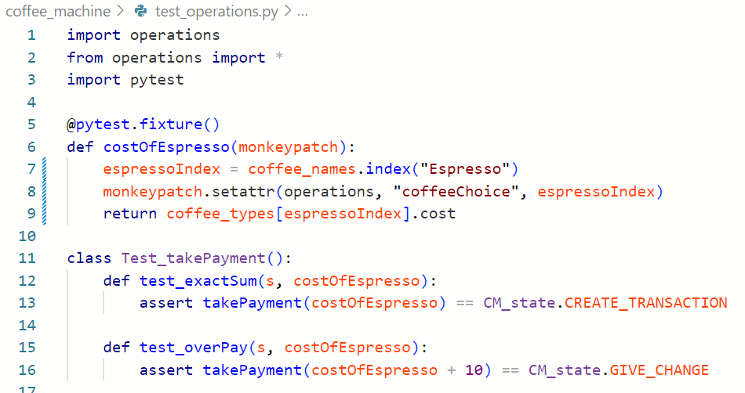
Fixtures
decorate a function
provide monkeypatch if needed
return a value
name fixture as test argument
use fixture value

Slide 7
Mock Global Variables
import module name for monkeypatch
name global in quotes
provide value

